Slide 1
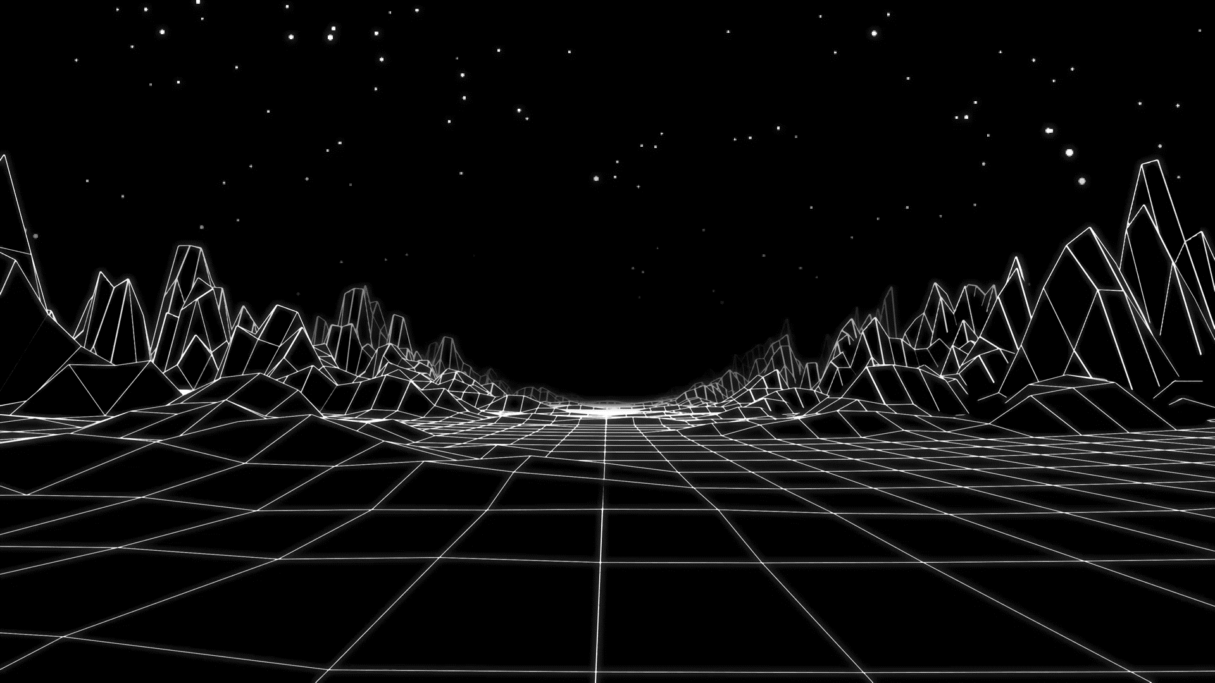
Bitcoin Transaction Safety
Saud Millwala and Melissa Williams

Slide 2
Our Question About Bitcoin Transactions
Digital currency is relatively new and unregulated
By analyzing a large sum of transactions that have happened over years we learn a lot more about this industry.
Our dataset can give insight to the amount of safety of these transactions
It is important for us to possibly discover how frequent fraudulent transactions are in this industry

Slide 3
About Our Dataset
We will be using the Bitcoin Heist Ransomware Address dataset sourced from the UCI Repository
The data points are comprised of fraudulent and non - fraudulent transactions taken place from January 2009 to December 2018.
This data set is comprised of 2916697 instances and 10 attributes
Due to the size of our original data, we conducted our analysis on a smaller portion

Slide 4
About Our Data Cont.
Additionally, the features of our data include :
address: String. Bitcoin address.
year: Integer. Year.
day: Integer. Day of the year. 1 is the first day, 365 is the last day.
length: Integer.
weight: Float.
count: Integer.
looped: Integer.
neighbors: Integer.
income: Integer. Satoshi amount (1 bitcoin = 100 million satoshis).
label: Category String. Name of the ransomware family (e.g., Cryptxxx, cryptolocker etc) or white (i.e., not known to be ransomware).

Slide 5
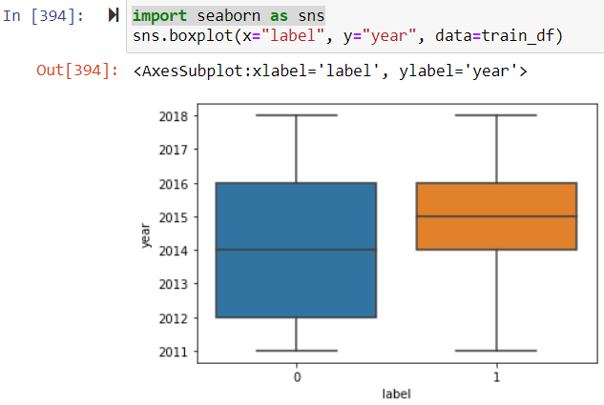
Our Plan for Analysis
Due to the size of our data we decided to conduct a Deep Learning Analysis
To prepare for that we conducted an Exploratory Data Analysis to better understand our data , here is one of the findings from our EDA:
Here, we can see a general ratio of fraud (label 0) to non-fraud (label 1) transactions from 2011-2018.

Slide 6
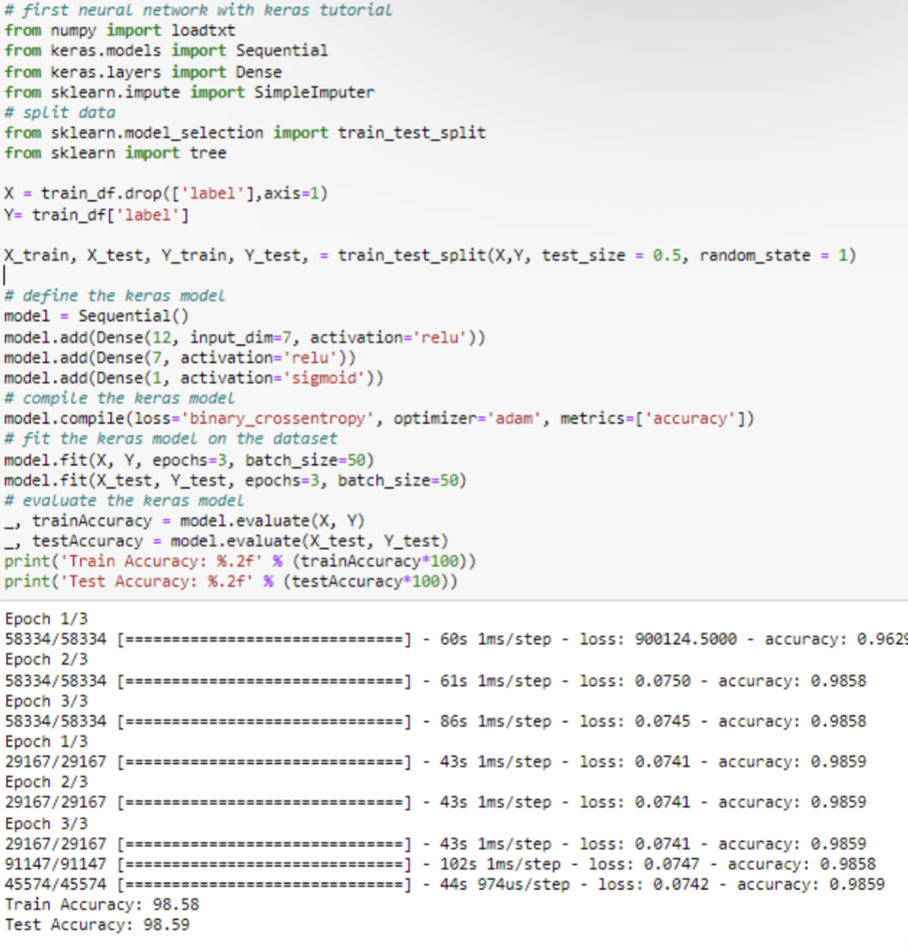
Our Model
The accuracy model gave an output of 98.58 percent.
Accuracy is (Total # of Correct Predictions)/(Total # of Instances)
More Accuracy of data sample = Greater correlation between the data
Batch Size- # of Samples processed before model is updated (ours was 58334 data samples & 29167)
Epochs- # of passed through data sample (3)

Slide 7
Comparing Our Model with Others
Judging by Recall being equal to 1 and Precision being equal to 0,
F-Score = 2( (Precision • Recall)/(Precision + Recall))
F-Score will be 0 and therefore undefined (bad classifier(Not Useful))
Allows us to conclude that Accuracy would be the best model to be used for this specific test case with the sample size used in this experiment.

Slide 8
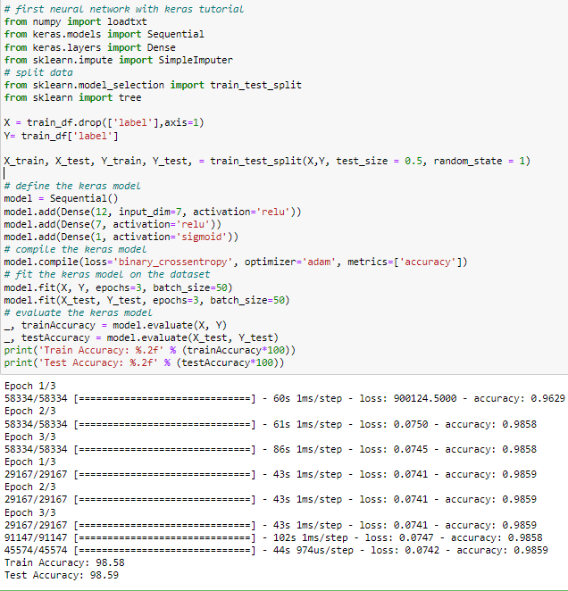
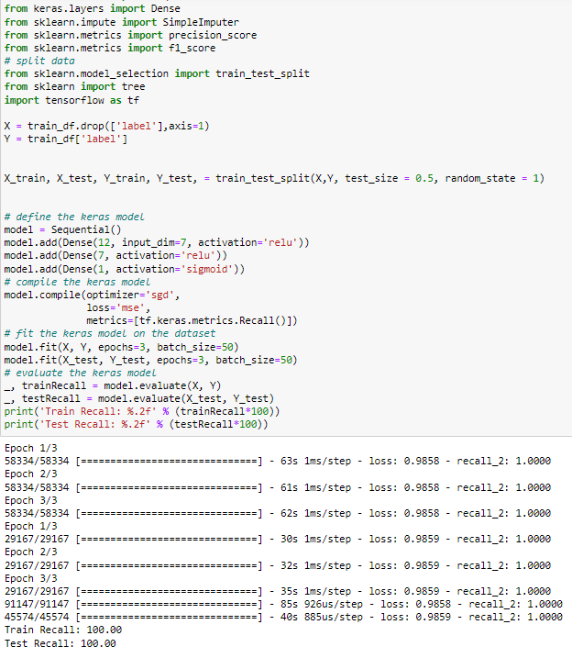
Accuracy Model: Recall Model:

Slide 9
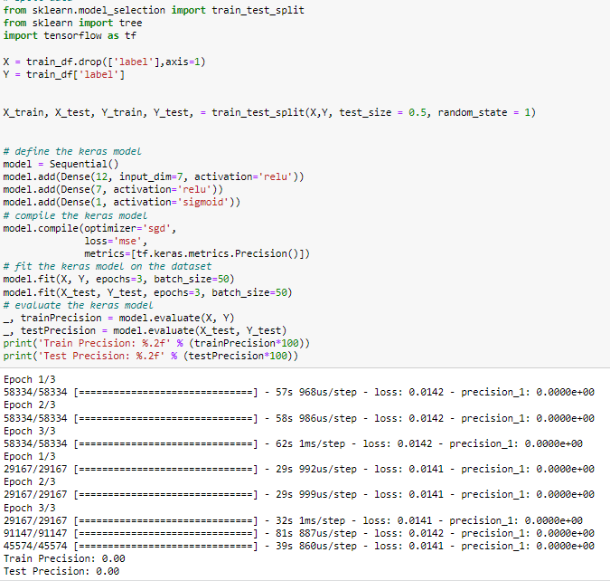
Precision Model: Accuracy Model:

Slide 10
What Does Our Findings Say About Bitcoin Safety?
The results of the data show that there is a correlation between the variables in our tests relative to Bitcoin Fraud.
The data points in the columns of Year, Day, Length, Count, looped, and Income all have a relation to label.
Correlation of fraudulent accounts to an increase in loop, count, and length which were all used to essentially hide the origin of the original address that had received the cryptocurrency.
bitcoin addresses are never hidden even if one goes through multiple hoops to hide where the paper trail of money goes.

